Slide 1
Capital Expenditures for Robotic Equipment
2018 Annual Capital Expenditures Survey (ACES)
Experimental Data Product
September 30, 2020
Anne Russell, Valerie Mastalski, Javier Miranda
Disclaimer: Any opinions and conclusions expressed herein are those of the authors and do not necessarily represent the views of the U.S. Census Bureau. The Census Bureau Disclosure Review Board has cleared the statistics in this paper for public dissemination. DRB approval 09/21/20

Slide 2
ACES Overview
Provides data on capital investment in new and used structures and equipment by private, non-farm businesses
Sample
  Employer businesses - 50,000
  Non-employer businesses - 20,000
Reporting Unit
  Data are collected at the company or firm level
Geographic Coverage
  National
Industry Coverage
  Select 3-digit and 4-digit NAICS industries in all covered NAICS sectors

Slide 3
Motivation/Strategy for Adding the Robotic Equipment Expenditures Question to the ACES
Data Gap
  Growing interest and high demand by researchers and congress, etc. on measuring robotics as part of official government statistics
    Measures of robot adoption intensity
    Impact on employment and productivity
Strategy
  Design the question in the same format as an existing question on the survey for capitalized computer software
Notes:
Add a slide or combine with this slide about strategy – why they question was added liked it was – data gap and opportunity

Slide 4
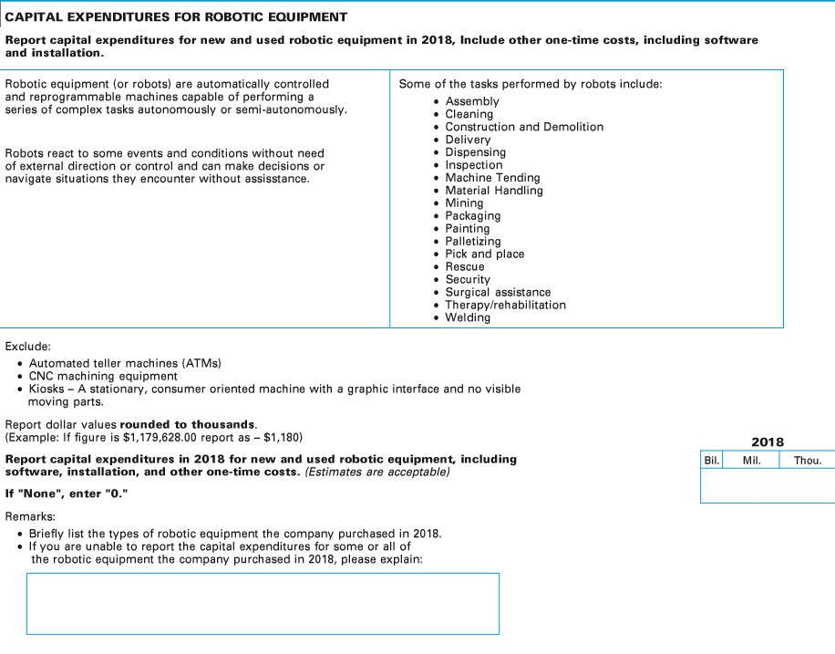
Robotics Question
Notes:
Too small? Split into two slides? Javi has three slides – check those slides out
Challenges with data collection (definitions – common inclusions that should have been excluded)
Remarks box – helpful
Insights from data collection
What we learned

Slide 5
Question

Slide 6
Question

Slide 7
Question

Slide 8
Question

Slide 9
Question

Slide 10
Question

Slide 11
Robotic Equipment Expenditures Editing - Online Reporting Instrument
Internal Soft Edits trigger warning messages:
  If both the $ value and the Remarks box were blank.
    “Please provide a $ value [If “None”, enter “0”] or provide an explanation in the Remarks box if no $ value can be provided.”
  If the $ value reported for robotic equipment exceeded the company’s total investment in equipment for 2018 reported in an earlier item.
    “Total robotic equipment should not exceed the total equipment, $X, you previously entered.”
Notes:
*3 slides for editing
*instrument edits
*Remarks box – analysts to validate data, remove things that weren’t robots, correct to zero when none was listed in remarks, identify companies that had robotics but couldn’t quantify
- Other edits

Slide 12
Analyst Review of Reported Robotic Equipment Expenditures Data
Multiple listings were created and made available to the staff to assist them in their review
  By sampled industry – company’s reported and weighted data and percent of industry total
  Aggregate total - descending order of weighted data, sampled industry and percent of total
  Dollar value > ‘0’ with Remarks
  Dollar value > ‘0’ but Remarks box blank
  Dollar value = ‘0’ and Remarks box not blank
  Dollar value missing and Remarks box not blank
  Dollar value missing and Remarks box blank

Slide 13
Analyst Edits of Reported Data
Reconciled Remarks box with reported data
  Adjust for out of scope equipment. Ex., kiosks
  Remarks indicate “no robots” but robot equipment expenditures is blank
Reconcile Robotic expenditures with other data items – Total capital expenditures and equipment capital expenditures
Respondent follow-up
  Request an estimate if remarks indicate robots but left robot equipment expenditures blank
  Validate/clarify type of robotic equipment

Slide 14
2018 ACES Response Rates
 | Percent
Unit Response Rate (URR) | 78.0
Total Quantity Response Rate (TQRR)
Capital Expenditures | 91.0
Robotic Equipment Expenditures | 90.1

Slide 15
Robotics Responses
 | Percent of Responses
Robotics Capex >0 | 3.1
Robotics Capex = 0 | 95.8
Robotics Capex – yes, not tracked | 0.2
Robotics Capex – unknown | 0.9
Total Respondents | 100.0
Notes:
Provide by sector
Rows 3 and 4 need imputation (change color)
Are respondents representative? Consider imputing by size.
Total payroll (sampled industry):
Respondents
1,152 > ‘0’ (Correction: 1,160) $ 486,175,277 (Correction: $501,292,106)
35,895 = ‘0’ (Correction: 35,968) $ 2,901,007,821 (Correction: $2,928,075,660)
463 – not tracked/unknown (Correction: 408) $ 227,074,486 (Correction: $223,163,457)
Total Respondents: 37,510 (Correction: 37,536) $ 3,614,257,584 (88.8% of total sample payroll (Correction - $3,652,531,223) (89.8% of total payroll)
Sample $ 4,068,856,215
Robo Cap – yes but not tracked – Correction : 63 (0.2% of respondents)
- unknown – 345 (0.9 % of respondents))

Slide 16
2018 ACES
Published Estimates and
Robotic Equipment Expenditures

Slide 17
ACES Equipment and Structure Expenditures Published Estimates
ACES data are collected at the company or firm level.
A single NAICS code is assigned to the firm at the time of sampling based on their primary business activity.
ACES equipment and structure expenditures are collected for all industries in which the firms operate and have capital expenditures.
ACES estimates are published at the national level and also by 2-digit NAICS sector and select 3-digit and 4-digit NAICS industries in all covered NAICS sectors for employer businesses.
Nonresponse is accounted for by sample weight adjustment

Slide 18
Example – Equipment Expenditures by Sampled NAICS compared to NAICS segment
 | Sampled NAICS | Equipment Expenditures (Firm Total) | Equipment Expenditures (Firm Total) 61 - Education | Equipment Expenditures (Firm Total) 62 - Health care and social assistance
Firm A | 61 - Education | $100,000 | $50,000 | $50,000
Firm B | 61 - Education | $75,000 | $75,000 | $0
Firm C | 61 - Education | $100,000 | $0 | $100,000
Total |  | $275,000 | $125,000 | $150,000
Sampled NAICS - A single NAICS code is assigned to the firm at the time of sampling based on their primary business activity.
NAICS segment - Firms report for all industries in which they operate and have capital expenditures.

Slide 19
Robotic Equipment Expenditure Estimates
The robotics question was asked for the firm and not for the industries in which the firm operates.
Robotic estimates are tabulated based on the NAICS assigned to the firm.

Slide 20
Imputation for Missing Robotic Equipment Expenditures
Firms that reported capital expenditures for equipment but did not respond to the robotic expenditures question are accounted for by imputation.
  Imputation method: Robotic equipment expenditures/total equipment expenditures * total equipment expenditures.
Source of imputation ratio:
  Firms indicating an investment in robotic equipment in their write-in field → the ratio was obtained from a similar firm in the same NAICS industry and strata (based on payroll).
  Firms that did not indicate an investment in robotic equipment → the ratio was obtained by calculating the average ratio of robotic expenditures as a percent of equipment expenditures in the same NAICS industry and strata (based on payroll).
Robotic estimates both reported and imputed were summed and weighted based on the sample weight adjusted for nonresponse of the capital expenditure estimate.

Slide 21
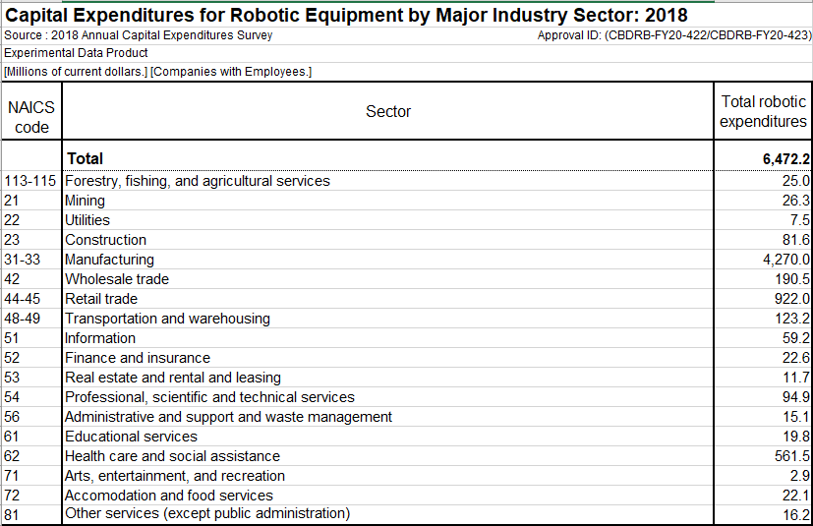

Slide 22
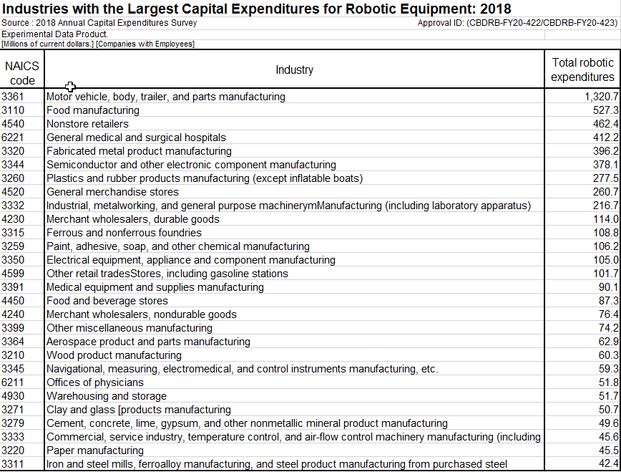

Slide 23
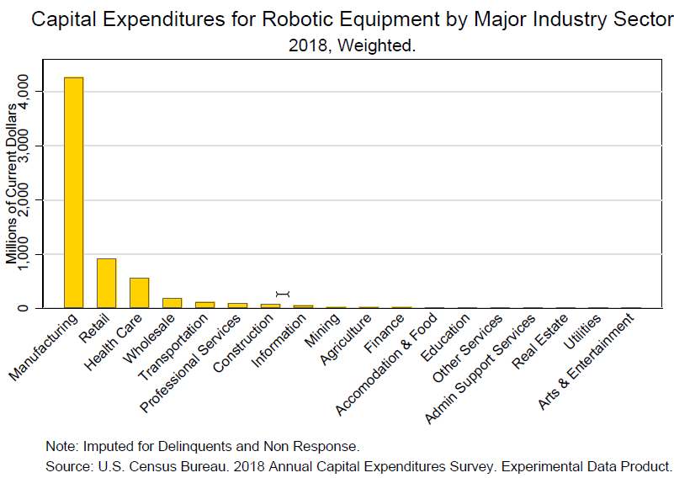

Slide 24
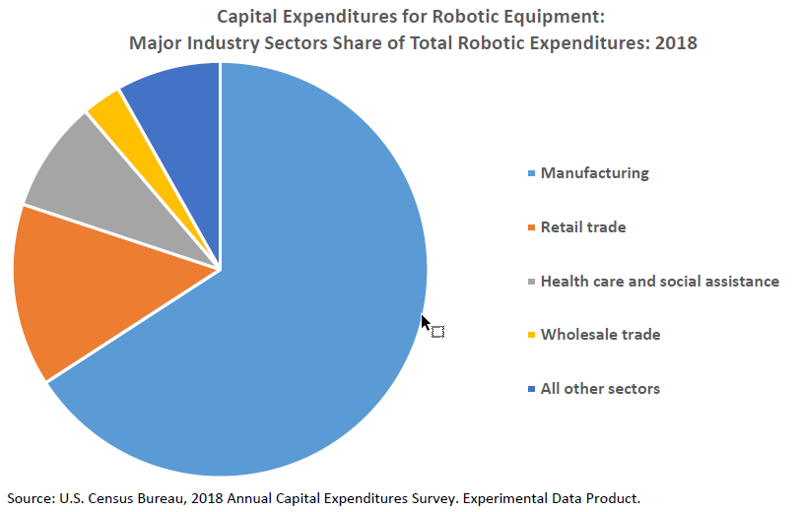

Slide 25
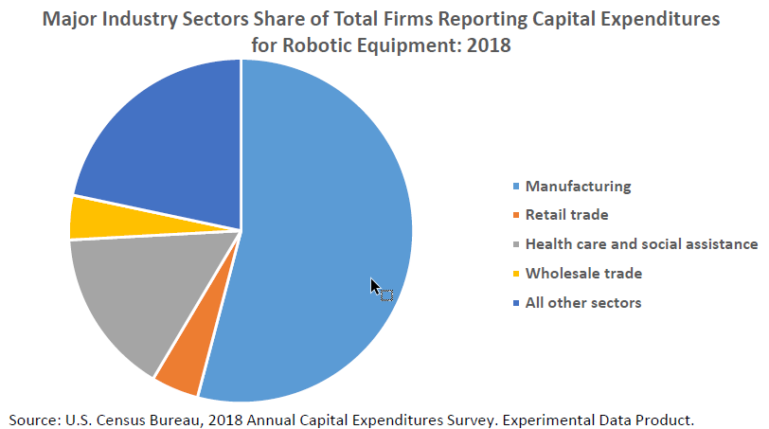

Slide 26
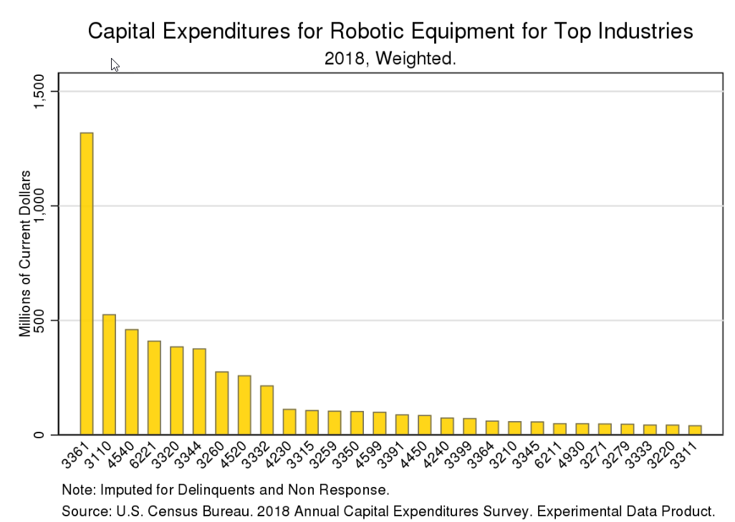

Slide 27
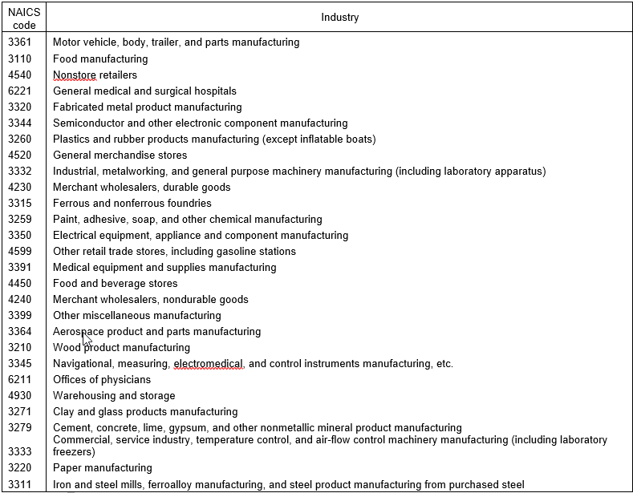
Industry Descriptions

Slide 28
Capital Expenditures for Robotic Equipment: 2018
In 2018, robotic equipment expenditures account for 0.6 percent of all equipment expenditures.
This is reflective of:
Investment in robotic equipment is not as prevalent in some sectors and industries.
  Top 4 sectors account for 91.8 percent of all robotic expenditures.
  Top 20 industries account for 80.9 percent of all robotic expenditures.
  Manufacturing accounts for 66.0 percent of all robotic expenditures.
Not all firms in a given industry invest in robotic equipment.

Slide 29
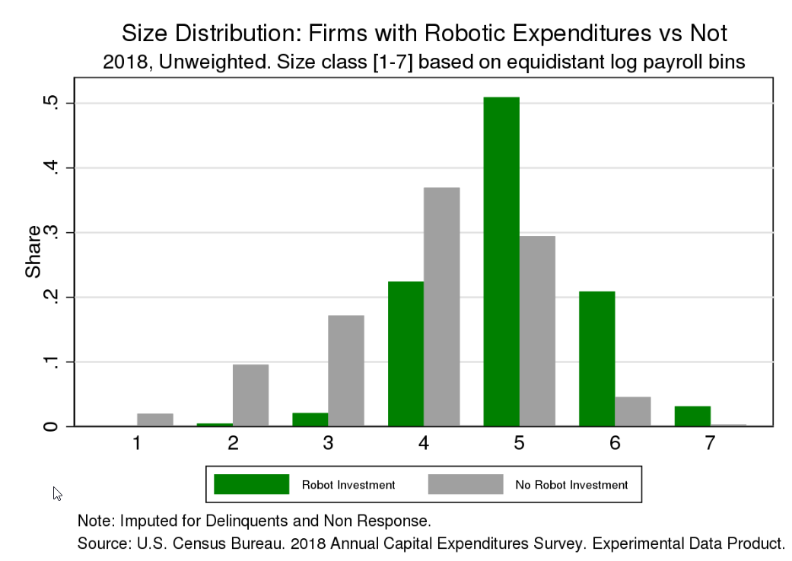

Slide 30
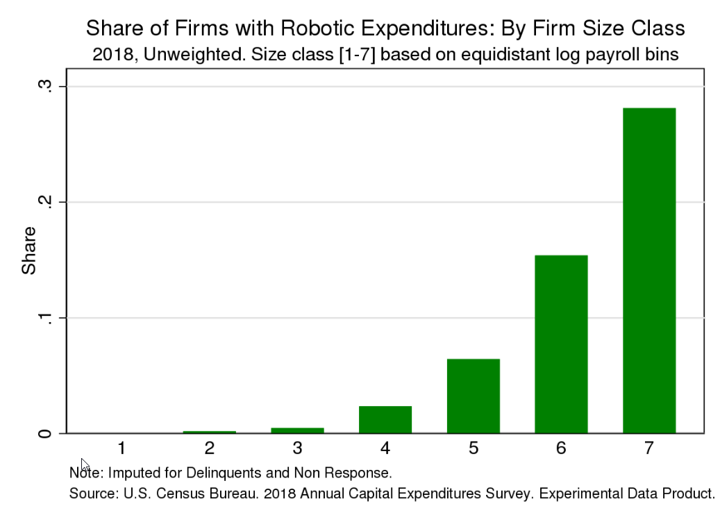

Slide 31
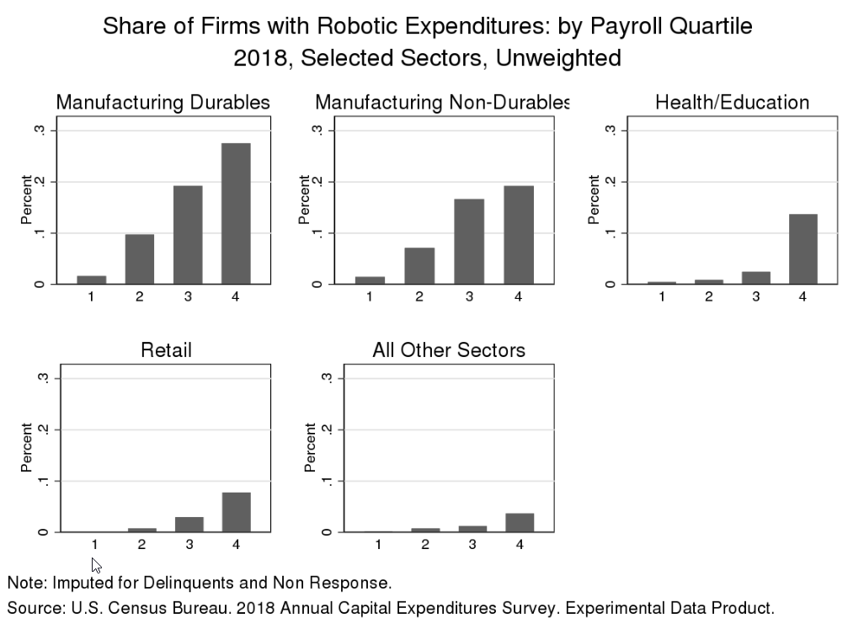

Slide 32
Census Contacts
Anne.Sigda.Russell@census.gov
Valerie.Cherry.Mastalski@census.gov
Javier.Miranda@census.gov

